Slide 1
How to use
Simply download this presentation template to edit and use yourself.
We hope you find the presentation useful.
Team ProdPad

Slide 2
Presentation Title
Subtitle
Date

Slide 3
Key Points
Introduce the key points that you will cover during the meeting.
What would you like to achieve at the end of the session? Set a tangible outcome(s)
Be clear about the scope of this meeting - otherwise you’ll run way past time!

Slide 4
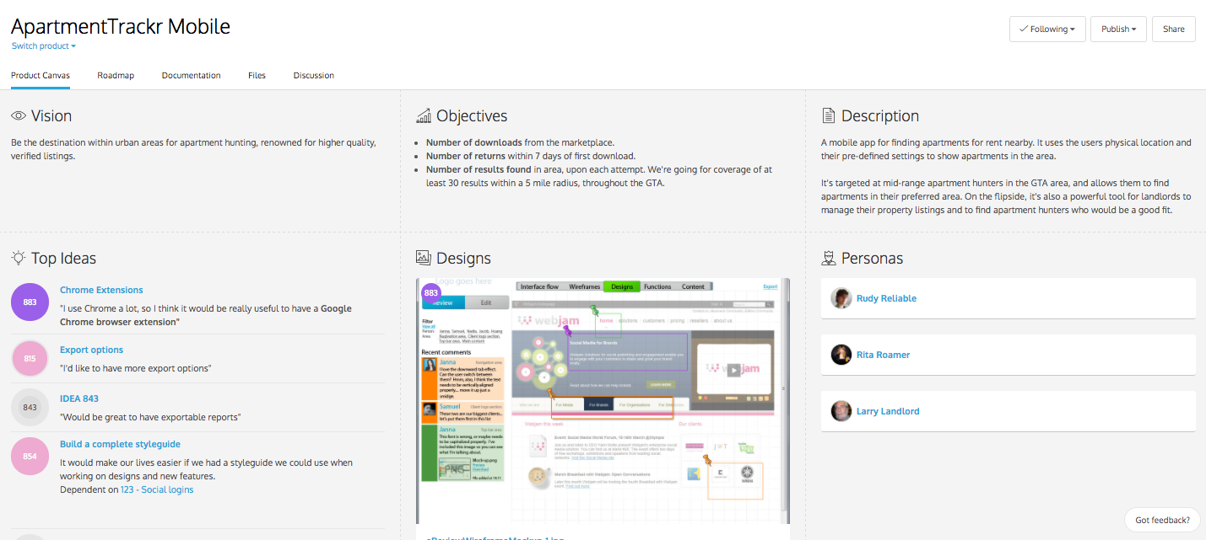
Introduce Product Canvas

Slide 5
Talk about the big picture
Remind everyone of your product vision. It all goes back to this, right? ;)
Remind everyone of your current business objectives/KPIs (and future objectives, if applicable)
Remind everyone of the direction you’re taking your product and how you’re setting yourselves apart in the market

Slide 6
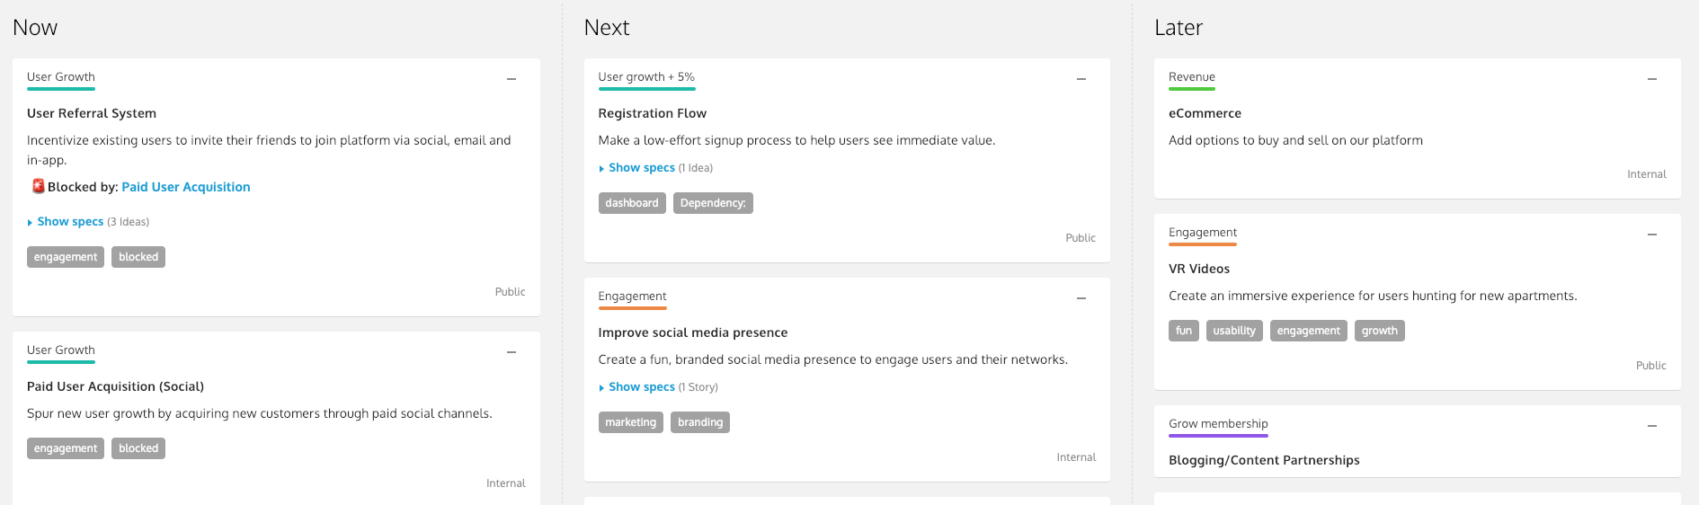
Introduce your roadmap
Talk about strategy!

Slide 7
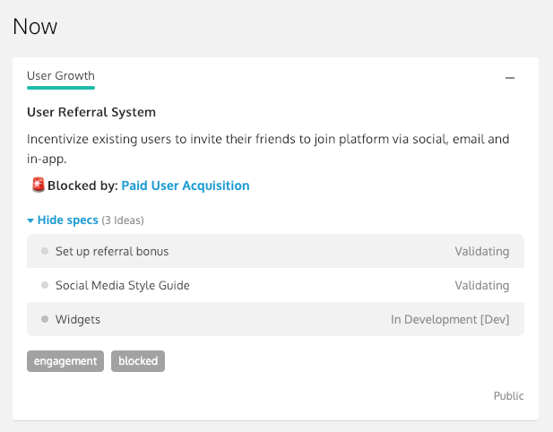
Talk about the ‘Now’

Slide 8
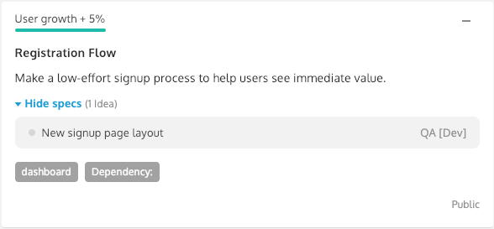
Talk about what’s next
Continue with as many slides as necessary and focus on each card individually.

Slide 9
Q&A Time
It’s Q&A time! Give your attendees and colleagues the opportunity to ask questions, bring up concerns and make suggestions.
Remember, product management is a team sport!

Slide 10
Make your roadmap accessible
Share your roadmap via URL or an embed code for your team to review at a later time.

Slide 11
Continue the discussion
In ProdPad, you can invite an unlimited number of team members to vote on and discuss ideas, contribute feedback and help you shape product specs.

Slide 12
Everything you need to build better products.
Build a beautiful, presentation-ready roadmap in minutes.
Start your free trial today!

